Slide 1


Slide 2
Agenda
Introduction to Docker Volumes
Docker Volumes types
Introduction to Docker Compose
How Docker Compose Works
Writing a Docker Compose
Introduction to Docker Swarm
Docker Swarm Architecture
Docker Swarm Discovery Services
Docker Swarm Scheduling
Docker Swarm Filtering
Creating a cluster with Docker Swarm
Introduction to Docker UCP
Monitoring Docker Swarm Cluster using UCP

Slide 3
Introduction to Docker Swarm
Docker Swarm is a clustering and scheduling tool for Docker containers
With Swarm, IT administrators and developers can establish and manage a cluster of Docker host systems, or nodes, as a single virtual system
Clustering is an important feature for container technology because it creates a cooperative group of systems that can provide redundancy if one or more nodes fail
Clustering also provides the ability to add or subtract container iterations, also called scalability, as computing demands change

Slide 4
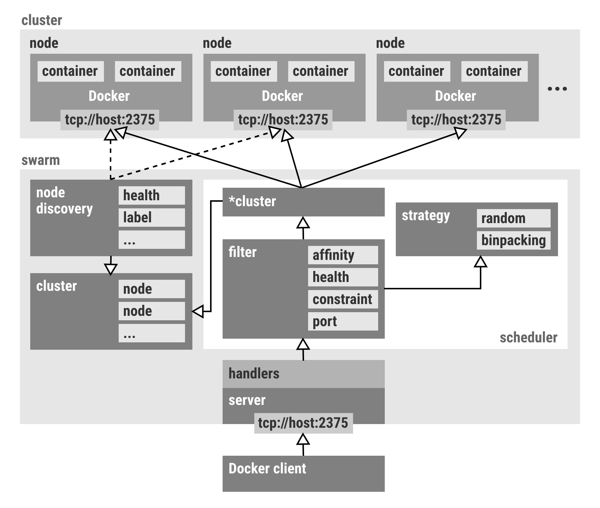
Docker Swarm Architecture

Slide 5
Docker Swarm Discovery Services
Docker Discovery Service is used to connect and communicate with the host nodes and maintains a list of IP’s in that cluster and shares it with the swarm manager

Slide 6


